Slide 1

DEPARTMENT OF COLORADO WORKSHOP VFW AUXILIARY SUICIDE PREVENTION
(MAKING PREVENTION EVERYONE’S BUSINESS)
October 2017

Slide 2
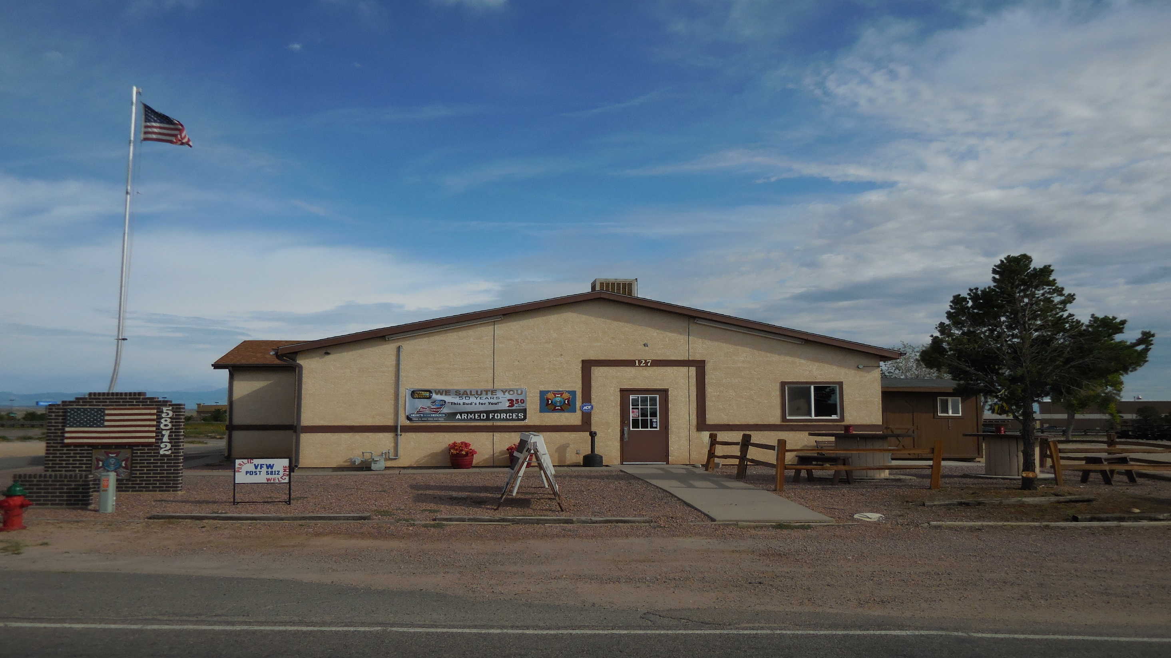

Slide 3

SOME BACKGROUND
17-22 US Veterans commit suicide each day--(Worldwide, suicides account for over 1M deaths per year). One suicide is one too many !
Over the last 10 years, more veterans (60,000) have died from suicide than were killed (58,000) in the war in Vietnam.
Colorado vet suicide rate is significantly higher than national average--42 (CO) vs 22.3 (Natl) deaths per 100,000 -- Recent slight decrease.
Suicide is an attempt to stop the pain—it is difficult to see and recognize all the signs.
Some main issues—legal difficulties, financial problems, relationship.
Aids to recovery—connectedness, housing, employment, education.

Slide 4
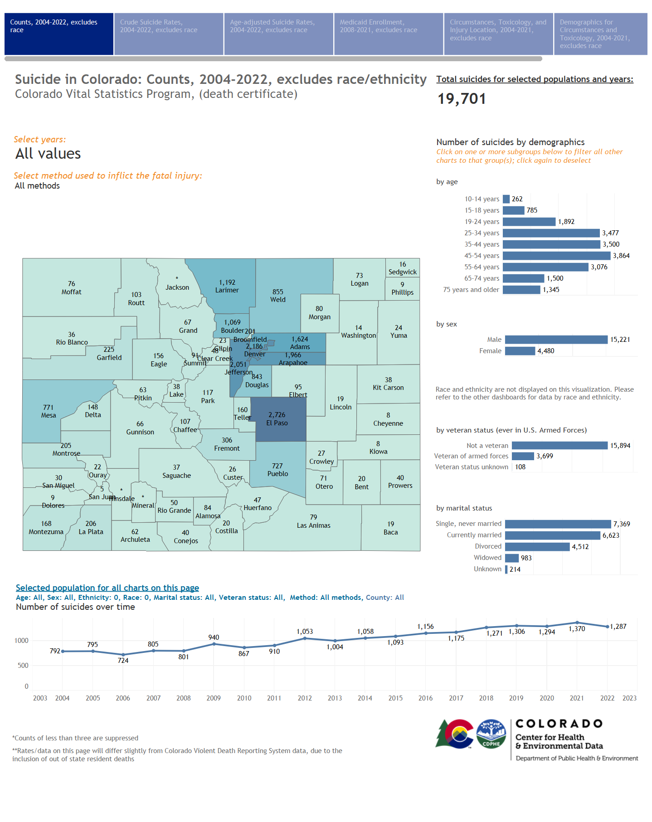

Slide 5


This Photo by Unknown Author is licensed under CC BY-ND

Slide 6
LEARN TO RECOGNIZE THE SIGNS
Sad or depressed most of the time.
Clinical depression: deep sadness, loss of interest, trouble sleeping and eating—trouble that doesn’t go away or continues to get worse.
Feeling anxious, agitated, or unable to sleep. Unusual calmness.
Neglecting personal welfare, deteriorating physical appearance.
Withdrawing from friends or family—sleeping all the time.
Losing interest in hobbies, work, school and other things one used to care about. Past suicide attempts.
Frequent and dramatic mood changes—punching holes in walls, rage, seeking revenge, getting into fights or other self destructive behavior.

Slide 7
LEARN TO RECOGNIZE THE SIGNS
Expressing feelings of guilt or shame.
Feelings of failure or decreased performance.
Feeling life is not worth living, having no sense of purpose or connectedness in life.
Talk of desperation or feeling trapped—there is no way out.
Narrowing of focus—without my unit, my wife, my job, I have no reason to live. Reaching out for help is not weakness—it is strength!
Giving away prized possessions, putting things “in order,” tying up “loose ends,” making out a will.

Slide 8
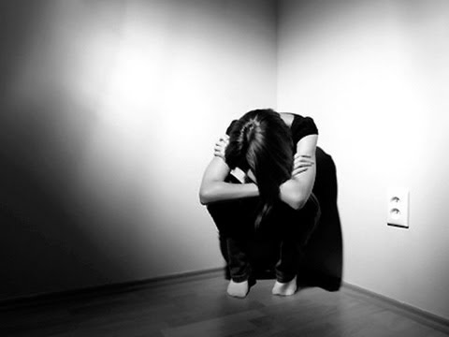

This Photo by Unknown Author is licensed under CC BY

Slide 9
LEARN TO RECOGNIZE THE SIGNS
Looking as though one has a “death wish” tempting fate by taking risks that could lead to death, such as driving fast or running red lights, leaving loaded firearms out (especially when this is a new behavior for this person).
Seeking access to firearms, pills or other means of harming oneself.
Increased alcohol or drug use. Watch for disturbing Face Book / Social Media postings. Watch for many negative events in this persons life in a short period of time.
Saying things like, “I would like to go to sleep and never wake up,” or “Everyone would be better off if I were dead.”
Saying things like “Nobody cares about me anyway.”
Females—sometimes seeking attention, Males—can be serious warning.

Slide 10
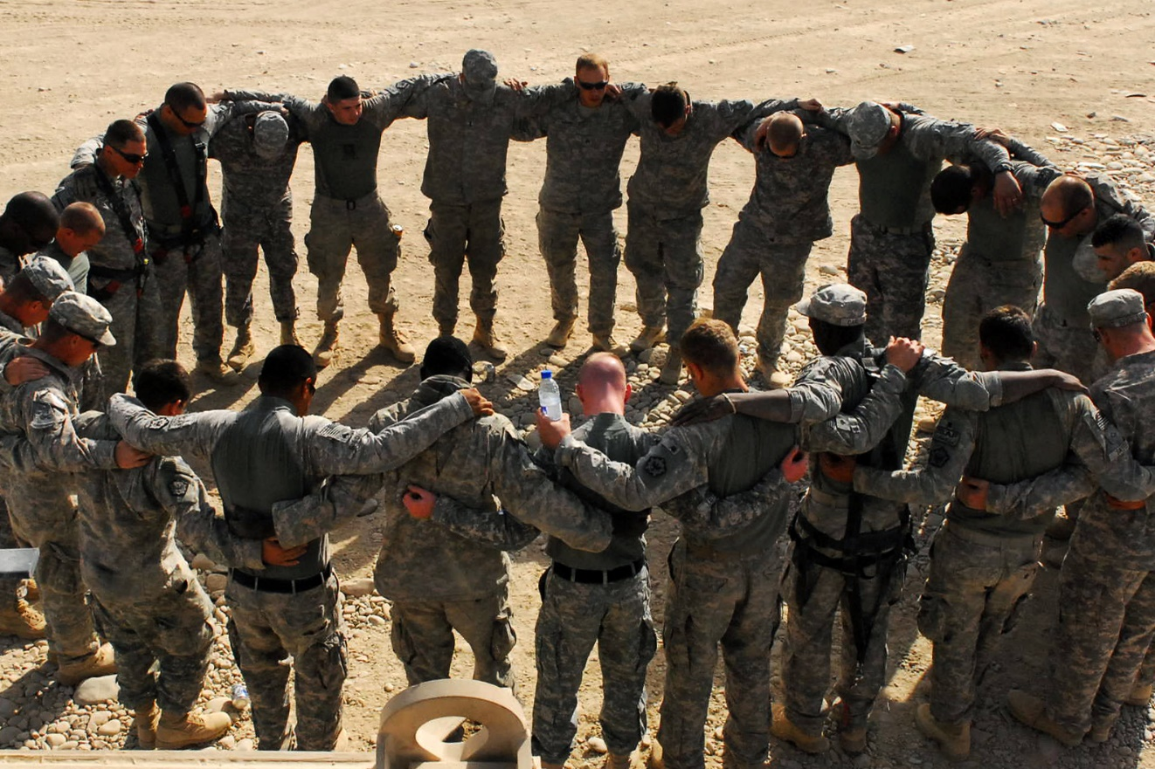

Slide 11
INSIGHTS
“Most people considering suicide want someone to save them. What we need is a culture in which no one is afraid to ask.”
Suicide is preventable—research shows that most of them do not wholeheartedly want to die. The first step in prevention is to find out if someone needs help. The best way to do that is to ask; most people in crisis are relieved when you do. And its easier than you might think.
Unadjusted Veteran suicide rate in 2020 was 31.7 per 100,000. Non-veteran was 16.1 per 100,000 – Veteran rate almost double.
Veterans who obtain assistance from peer support specialists continually sing their high praises. (Peer to peer programs work !)
At risk individuals usually do not substitute means—put some time and space between them and their method.

Slide 12


Slide 13
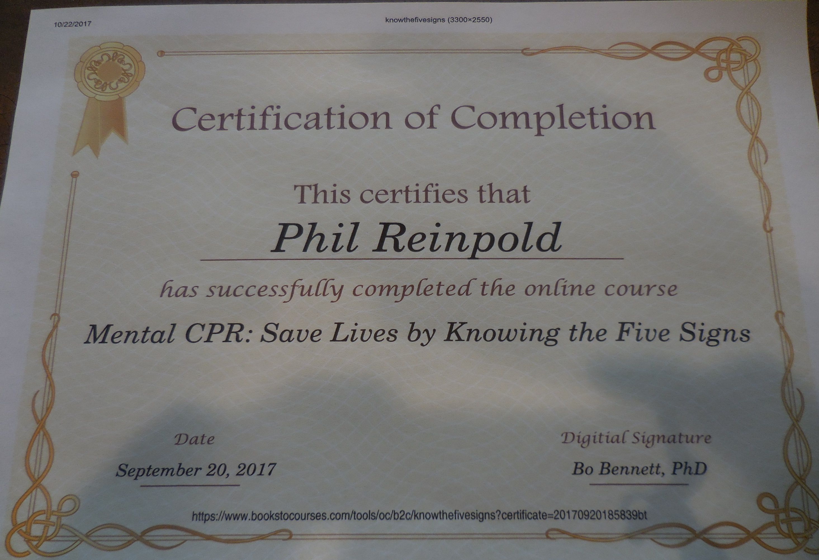

Slide 14
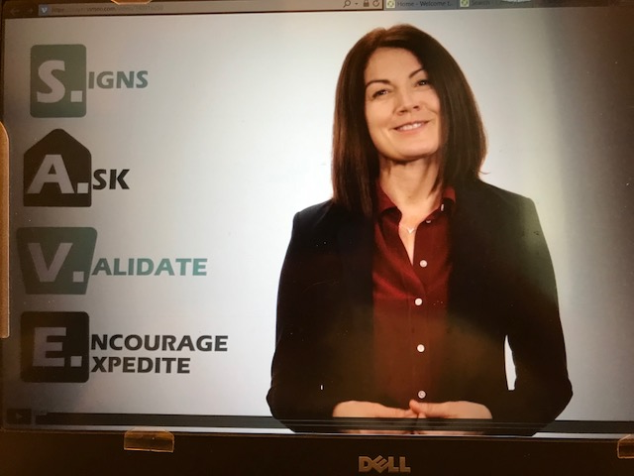

Slide 15
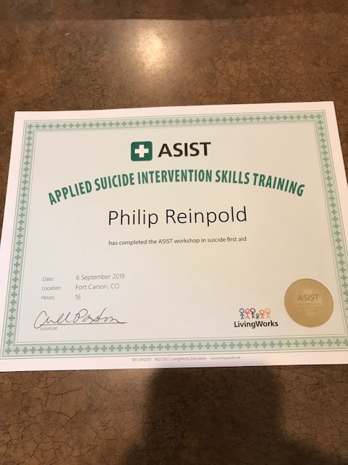

Slide 16


Slide 17
JUST ASK !
Have you wished you were dead or wished you could go to sleep and not wake up ?
ASK-Have you actually had any thoughts of harming or killing yourself ?
ASK-Have you been thinking how you might do this ?
ASK-Have you had these thoughts and had some intention of acting on them ?
ASK-Have you started to work out or worked out the details of how to kill or harm yourself ? Do you intend to carry out this plan ?
ASK-Have you ever done anything, started to do anything or prepared to do anything to end your life ? (If yes, Was this within the past three months ?)
Do not put yourself at risk—Do not “Ask” on your way out the door.
**For further information, please go to www.cssrs.columbia.edu **

Slide 18
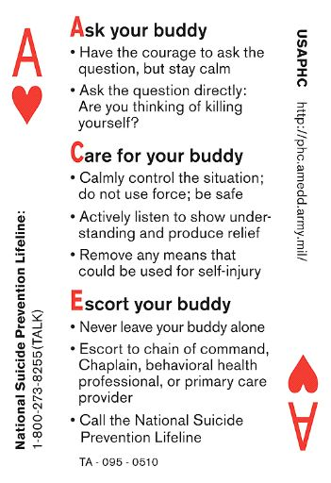

Slide 19
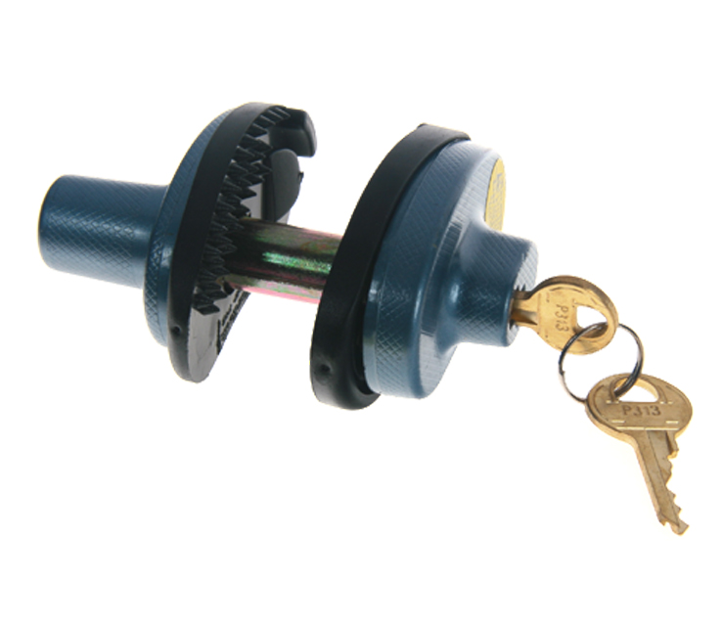
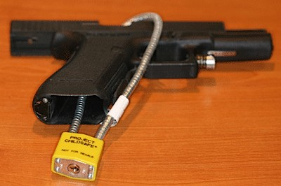
GUN LOCKS

Slide 20
CONTACTS
CALL 988 or 911
Veterans Crisis Line
1-800-273-TALK (8255) Press 1 or VA Medical Centers Press 7
Text to 838255
MilitaryCrisisLine.net
Be There—Peer Support
1-844-357-PEER (7337)
1-480-360-6188 (Text)
BeTherePeerSupport.org
Objective Zero—Zero Suicides
Connecting Veterans to Veterans and Support
www.objectivezero.org
Local Hospital Emergency Room

Slide 21
WHAT CAN I DO TO HELP ?
Continue to learn more about this subject—Take troubled individuals seriously !
Offer to hold firearms for someone who is in distress.
It may take more than one ask—follow up with those in trouble—let them know that help is available to assist them in getting through this.
If not you, decide who a good contact person at your Post would be.
Give a presentation to your Post and Auxiliary—include bartenders, employees, and others that could spot and assist those in trouble.
Work in your community to establish your Post and Auxiliary as a community partner in this prevention effort.
Put the word out—contact media, gun shops, City Councils, etc. to let them know that your VFW has made Zero Suicides a priority.
Identify “Hot Spots” in your community—work to eliminate them.
Let us know what you are doing—let us know what has worked for you—let us know of your successes and your struggles….
Realize sometimes you have done all that you can do –you are not responsible for other’s actions.

Slide 23
CREDITS
Slide #3—see links on photo.
http://the conversation.com/getting-the-facts-about-the-refugee-and-migrant-mental-health-in-Australia (Photo).
http://creativecommons.org/licenses/by/2.5/ (Licenses and Copyright).
Slide #6—see links on photo.
http://www.ccoli.com/videos/yt-F5YubjEqbZ8 (Photo)
http://creativecommons.org/licenses/by-nd/4.01 (Licenses and Copyright).
Slide #9—www.army.mil
Slide #12—odysseyonline.com
What happens when you take a moment to help !
The Columbia Lighthouse Project—Identify Risk. Prevent Suicide. www.cssrs.columbia.edu
*Please note that the licensor is not endorsing VFW, VFW Auxiliary or use of this material concerning Suicide Prevention by the use of these photos or materials.

Slide 24
PHIL REINPOLD CONTACT INFORMATION
preinpold@q.com
(719) 252-5667

Slide 25
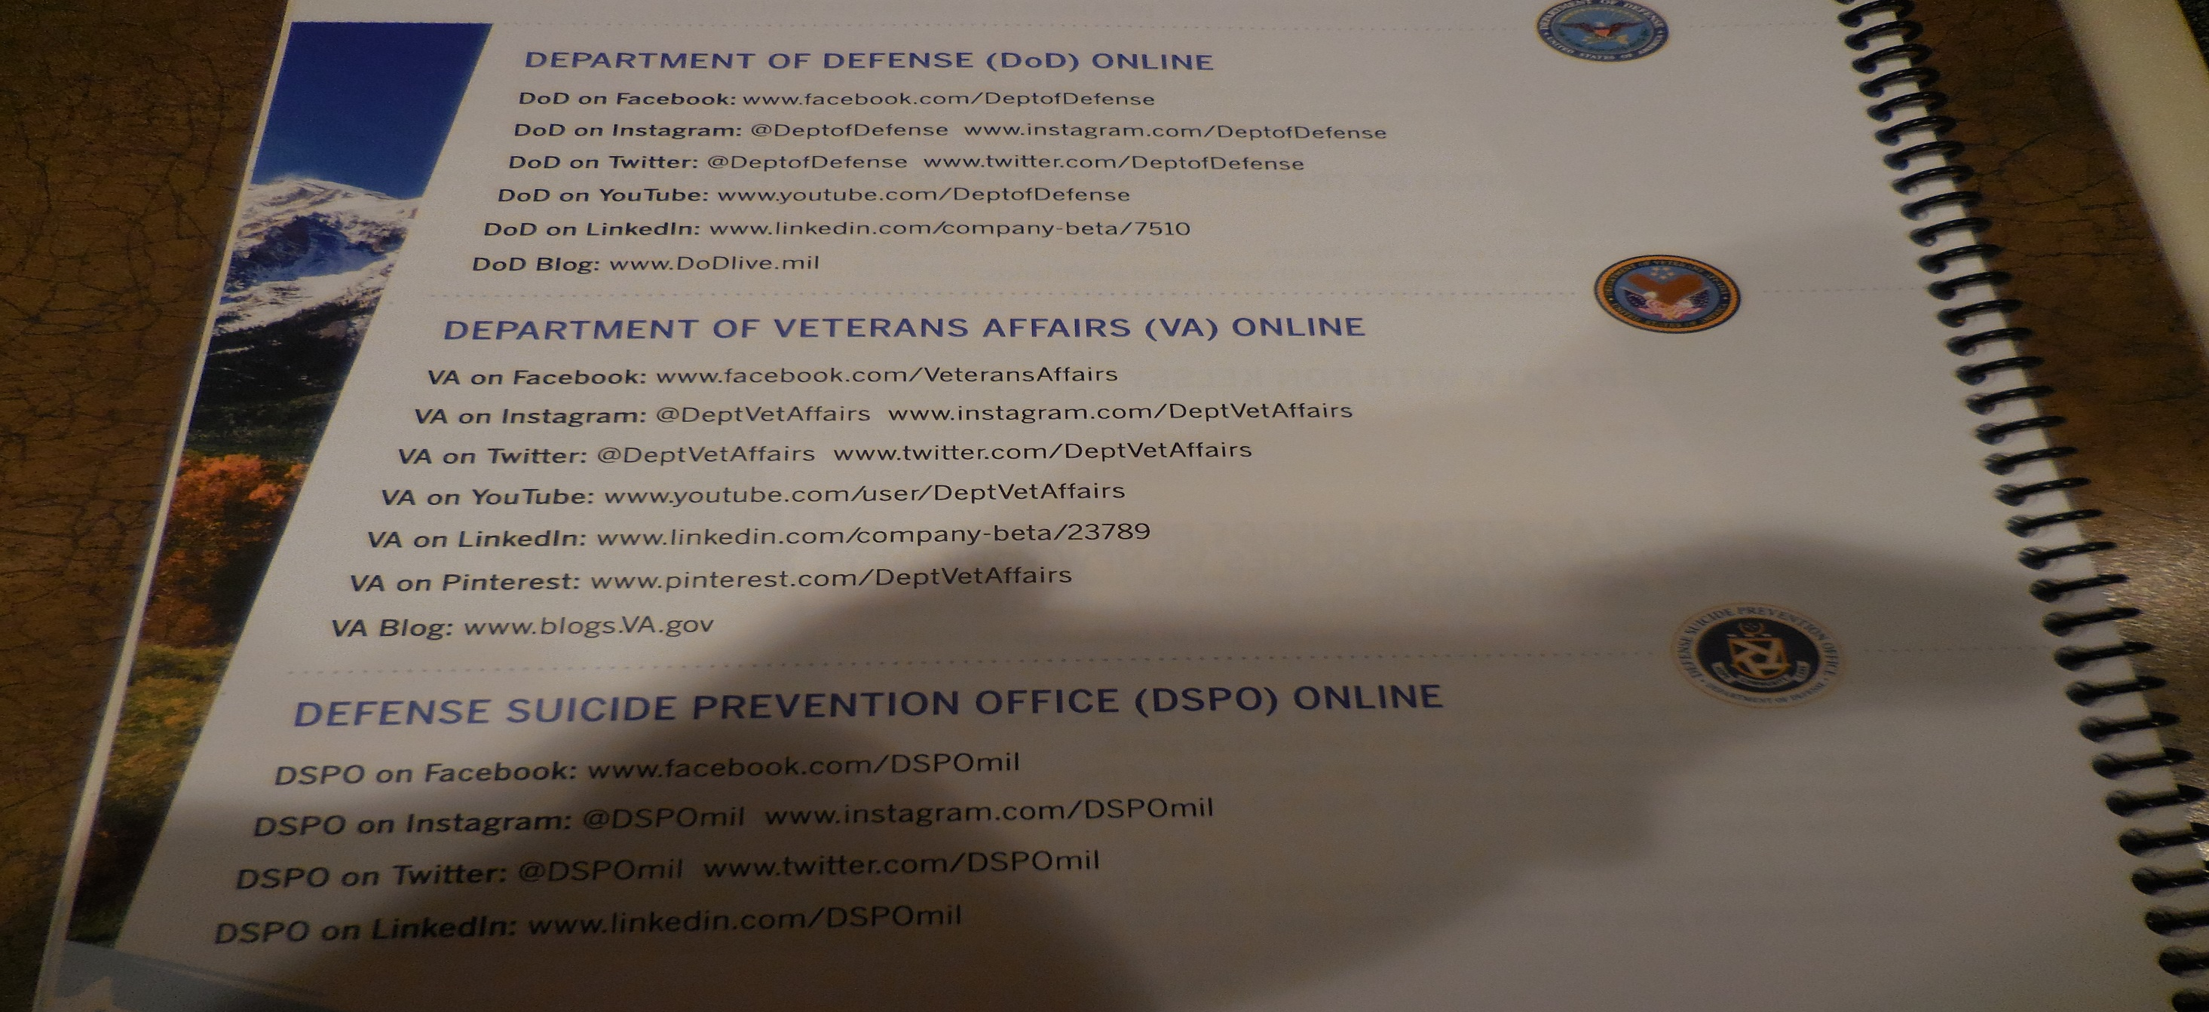
RESOURCES

