Slide 1

Grants

Slide 2
Adopt-a-Unit
Run by Military Assistance Program – map@vfw.org
121k military & family currently supported
VFW Posts work with unit commanders and senior enlisted personnel to develop supportive relationships with units before, during and after deployments.

Slide 3
Adopt-a-Unit
Family Days
Welcome Home & Deployment events
Holiday events
Direct assistance (relief fund)

Slide 4
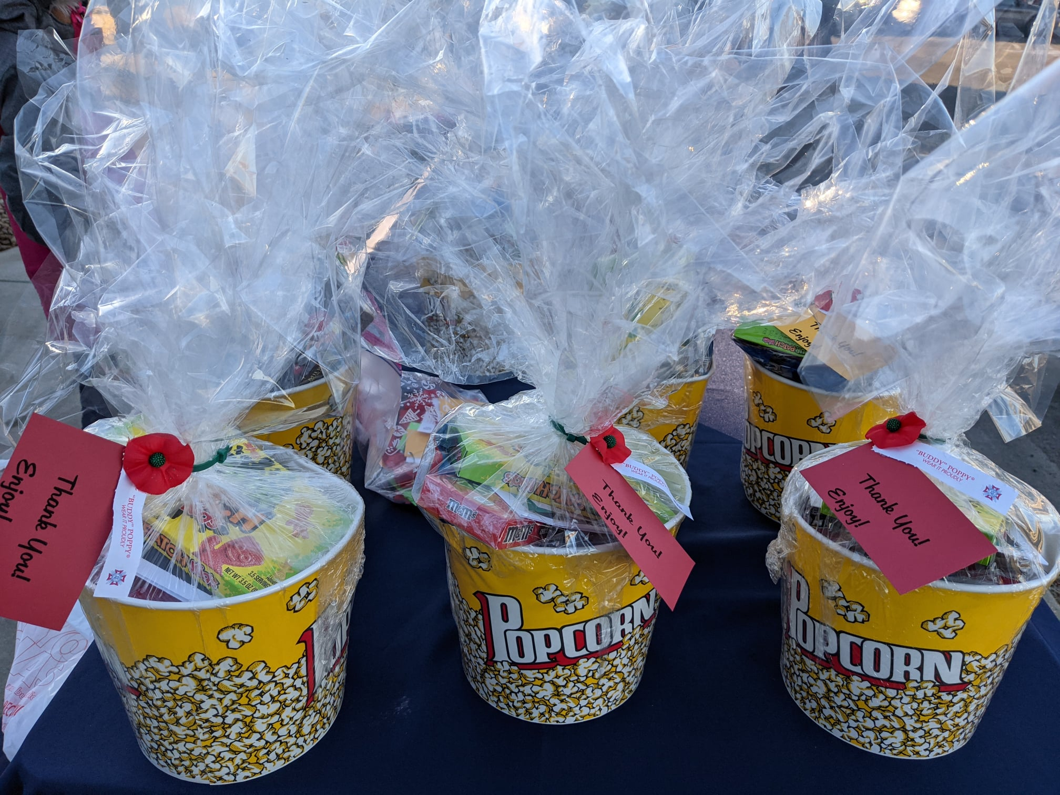
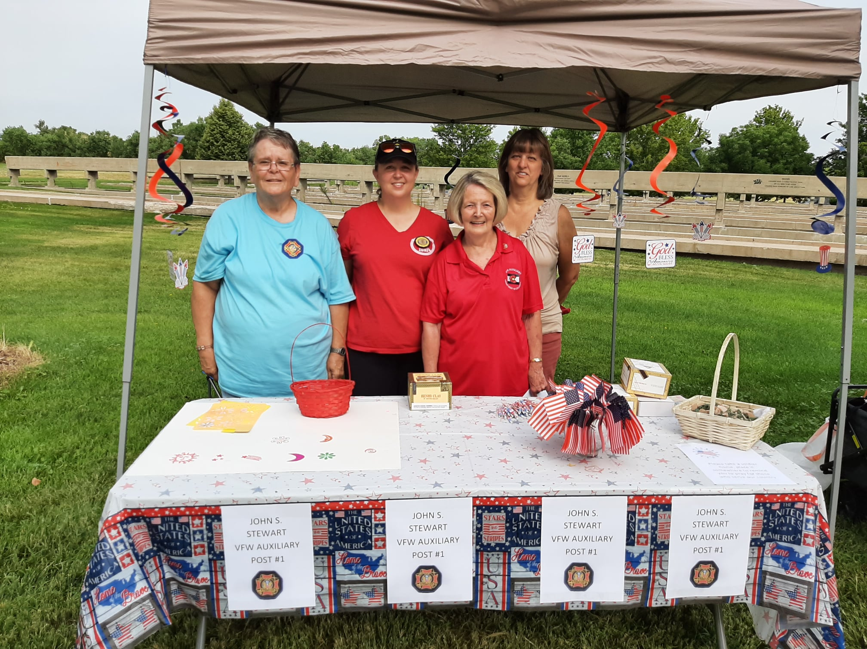
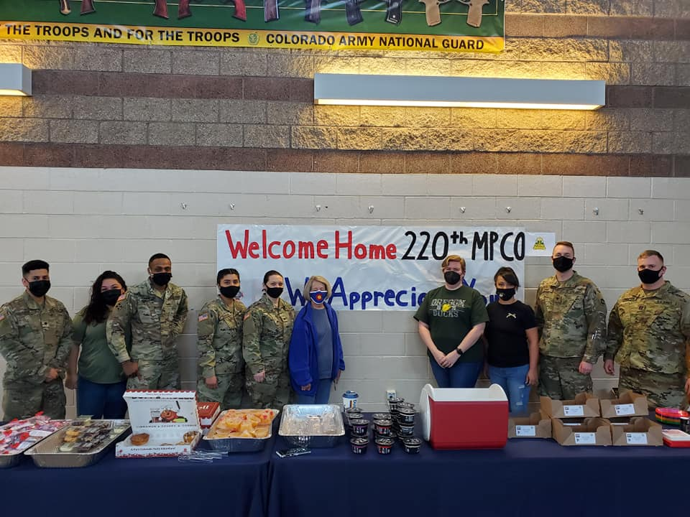
Adopt-a-Unit

Slide 5
MAP Grants
Basic food and non-alcoholic beverages for currently serving military and their family members only
MAP Grants cannot be used for Public Events and/or Formal Military events
Notes:
$4500 for Family Day event at Buckley

Slide 6
#StillServing Grants
Community Support Grant ($1000)
Corporate Partnership Grant ($1500)
Community Volunteerism Grant ($1000)
Notes:
A Post and its Auxiliary can each receive the full $3500 per year.

Slide 7
Community Support Grant
Community Outreach
Financial or in-kind donation (passthrough)
Repairs or upgrades to a Post building (limited)
Notes:
A couple of years ago the Department of Kentucky ran a program where they provided toys to children whose parents had passed. In Missouri last year, the Department ran a program where ruck sacks were filled with hygiene items and were then donated to homeless individuals. Post 1 is under construction and received $1000 in November.

Slide 8
Corporate Partnership
Community Service Projects
VFW National Partners
Humana, Walgreens, Ace, Sport Clips, Burger King
Requires an email or letter from the Partner
* These events can also be used for the All-American program
Notes:
This year, the Department of Tennessee is having a funding raising event with Humana where they are attempting to create the world’s largest toilet paper pyramid. Proceeds and the toilet paper will be donated to homeless shelters and veteran homes after the event.
Post 1 and the Aux has partnered with Humana to host a Vietnam Era Veteran pinning ceremony on June 25 ($1500 each).

Slide 9
Community Volunteerism
Unrestricted grant
Based on volunteer hours
An hour = $1
Min 500 hours – Max 1000 hours
Service project must involve a community partner
* Not restricted to the National Partners
Notes:
Post 1 logs hours hanging art at the VA hospital, displaying art at the Englewood library, the PACE Center, and the State Capital.

Slide 10
Uniting To Combat Hunger
Matching grant – Min$500/Max $5,000
Every pound of food = $1
Every dollar raised = $1
Every volunteer hour = $1
* Any volunteer hours that address food insecurity count
Notes:
Donor made up difference so Post 1 got full $5000

Slide 11
Colorado Veterans Project
Looking for support with a beer event in Colorado Springs in mid-late July
Rocky Mountain Vibes Stadium, Co Springs
Participating Posts can receive up to $5000 in support of UTCH

Slide 12
My Contact Info
John Keene
john@vfwpost1.org
303-547-7578
Notes:
I grew my business with coaching/mentoring and accountability. I will make myself available to any Post that wants to work with this system.

