Slide 1

Membership
Notes:
I look to support Commander Green’s Membership goal to recruit, retain and mentor a stable membership base that includes all generations of veterans. How?
In business, it is easier to retain a customer than find a new one. Which means, a happy customer is your best resource for repeat business. How many loyalty cards are each of you carrying right now?
Likewise, if we keep our current members engaged, by extension everyone becomes a recruiter. What do they say, the best advertising is “word-of-mouth” advertising?
Additionally, if we focus on the mission of the VFW, and get out in the community, our good deeds will also lead to opportunities to recruit new members.

Slide 2
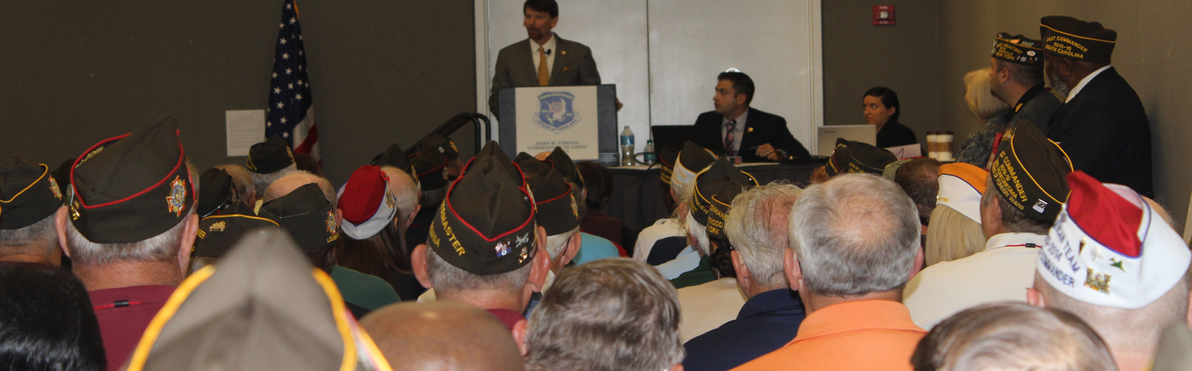
We Are a Non-Profit
Post 1 was Small Non-Profit of the Year in 2014
Gave a class at the National Convention in 2015
All-American Post 3-years running
Notes:
Post 1 History Lesson: 2003 charter was pulled, almost went under. Sold our building and were determined not to re-create a business that didn’t work in the past. We let the members decide our new direction, focus on wellness. Now an art gallery and yoga studio. No canteen.
After Post 1 changed our mindset, good things started happening. Denver Chamber Award. Gave a class at the 2015 National Convention. 100% at least the last 5-years (probably longer).
We are tax-exempt, we fundraise, we elect a board, we support our communities. We do all the things that “traditional” non-profits do, but with all volunteers!

Slide 3
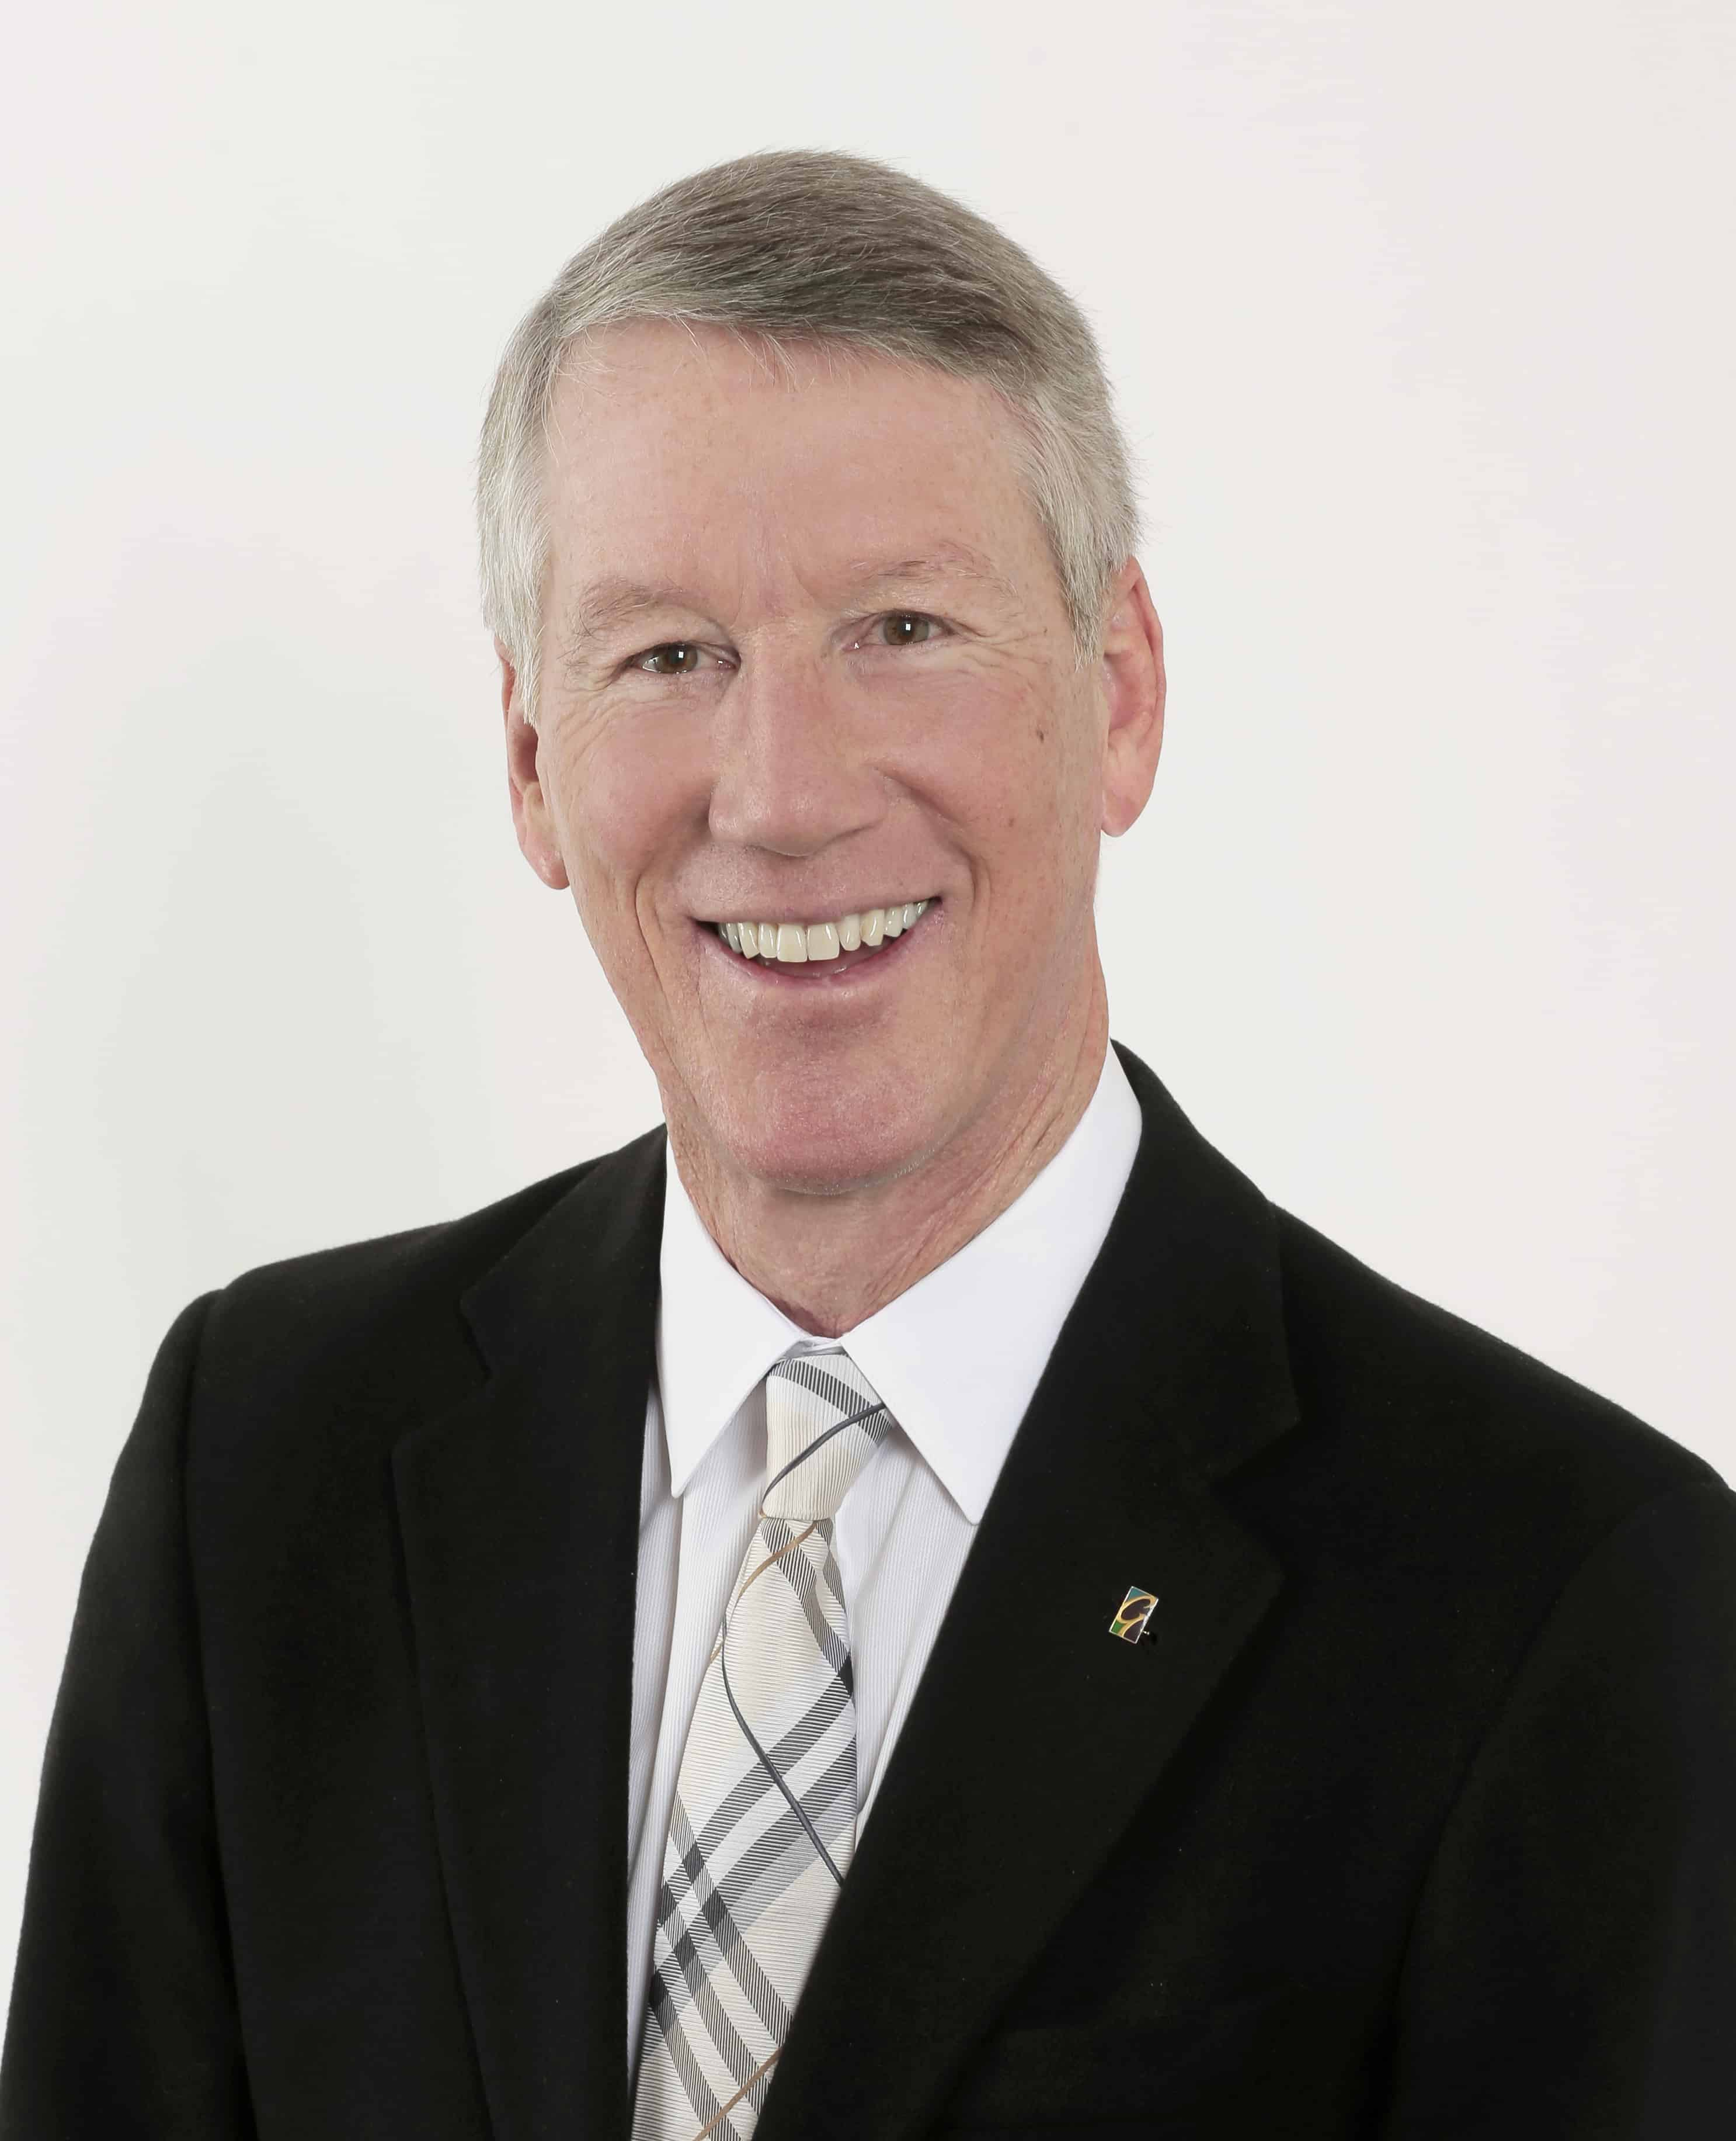
Larry Kendall
Author of Ninja Selling
Focus on the activities and the business will follow
Ninja Nine
Notes:
Larry Kendall is a mentor of mine, who helped me develop and grow a successful real estate business. Before I started following Larry’s program, I did 6-8 deals a year. I now average 20+ per year (about 2-month). As Larry says, I was an on-accident REALTOR, now I’m on-purpose.
The key was following a plan referred to as the Ninja Nine, or daily habits for success. The Ninja Nine will help retain current members and attract new members. Larry, a Vietnam era veteran, has endorsed the concept of applying the Ninja Nine to the VFW.

Slide 4
VFW Ninja Nine
Show up
Gratitude
Handwritten Notes (two/day)
Focus on Programs
Focus on Community Involvement
Notes:
These steps can be completed by a committee. Commanders do not have to go it alone.
Showing up is an attitude, not a location. Beginning your day in a space of gratitude creates a great framework for the day.
#3: Send birthday cards, thank you cards, thinking of you cards, etc. Be a Facebook stalker.
#4: Do your programs. VOD/PP/TOY/First Responder/Buddy Poppies
#5: VFW Warriors, Food/Toy Drives, Parades, Boy/Girl Scouts, National partners (see new All-American requirements), MAP Grants, UTCH w/ Humana

Slide 5
VFW Ninja Nine
Buddy Checks
Meet with 2 members a week
50 live contacts a week
Update your database
Notes:
#6: FORD calls (Family, Occupation, Recreation, Dreams)
#7: Sit down with your members. Go out for coffee, pop by their house, play golf, etc.
#8: Kids games, Rotary Club, bowling league, whatever you are into. Includes Buddy Checks when you connect.
#9: Add birthdays, verify phone/email addresses.

Slide 6
Phone Burner
Auto-dialer (not robo-calls)
Efficiently call your members
  Called 98 numbers in 90 minutes after fire
  18 live conversations
  Paula Underwood
Not exclusively for renewal calls

Slide 7
FORD Questions
(F)amily
(O)ccupation
(R)ecreation
(D)reams
Pleasure or Pain

Slide 8
Adopt-a-Unit and MAP
Military Assistance Program
Post, Aux, or both
Connect military members with VFW resources
Welcome home, family day, picnic, yellow ribbon, holiday parties, care packages, etc.
MAP grants to support these events

Slide 9
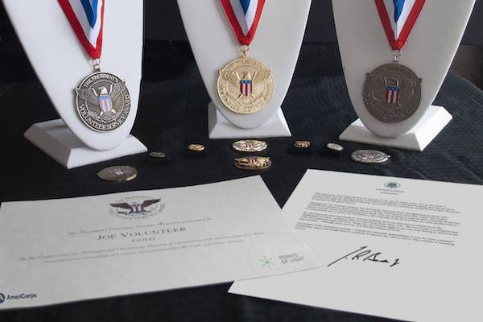
Presidential Service Awards
Notes:
A way to get involved in the community is by recognizing volunteers, in and out of the organization.
Age based awards. Eligibility is based on unpaid acts of volunteer service benefitting others.
i.e., All-State Honor Guard, Post Volunteers (help during construction, art at the VA Hospital/State Capital, etc)
PresidentialServiceAwards.org $5 cert. $6.50 + pin. $10.50 + coin or medallion

Slide 10


Member Appreciation
Notes:
www.boomerangdm.com Between $6-10.50/year per member. Set it and forget it.
Available up and down the front range and Grand Junction (examples above)
Member of the Month?
This goes back to the VFW Ninja Nine and the 1-on-1s with your members

Slide 11
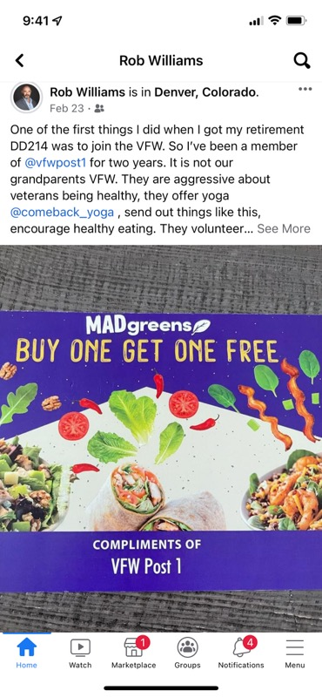
One of the first things I did when I got my retirement DD214 was to join the VFW. So I’ve been a member of @vfwpost1 for two years. It is not our grandparents VFW. They are aggressive about veterans being healthy, they offer yoga @comeback_yoga, send out things like this, encourage healthy eating. They volunteer…

Slide 12
Coaching/Mentoring
John Keene
john@vfwpost1.org
303-547-7578
Notes:
I grew my business with coaching/mentoring and accountability. I will make myself available to any Post that wants to work with this system.

