Slide 1
Toxic Exposure
VA Market Assessments
VA Proposes Updates
Steve Kjonaas
VFW Colorado Legislative Director
Steve@VFWCO.Org

Slide 2
Toxic Exposure Legislation
Action Alerts
TV News
Facebook
Tweeter
Instagram
  We made it pretty hard not to notice that Toxic Exposure is the VFW’s #1 Legislative Priority
Join Action Corps! Text “VFW” to 50457 or Visit vfw.org/JoinActionCorps

Slide 3

Toxic Exposure Legislation
H.R. 3967 The Honoring Our PACT Act passed the House and is in the Senate

Slide 4
Toxic Exposure Legislation
Leave No Veteran Behind
The Honoring Our Pact Act is set to improve the provision of health care and other benefits from the Department of Vet Affairs for 3.5 million Veterans who were exposed to toxic substances, and for other purposes
H.R. 3967 - Honoring our PACT Act, is perhaps the most ambitious and comprehensive legislation introduced to date on military toxic exposures
For claims involving toxic exposures, the burden of proof falls far too heavily on the Veteran. This is a significant barrier to Veteran’s access to care
Join Action Corps! Text “VFW” to 50457 or Visit vfw.org/JoinActionCorps

Slide 5
Toxic Exposure Legislation
Leave No Veteran Behind
On passage the vote was 256 – 174 in the House
The Honoring Our PACT Act will serve 3.5 million Veterans
The Congressional Budget Office on February 28th reported that the bill will cost $208B over 10 years
Taking care of our veterans is a cost of war
Senate pulse check related that one of our Senators needs a few phone calls and emails
We need you to write and or call Senator John Hickenlooper to express that you are;
A resident of Colorado
A military veteran, a family member, a friend, seen the TV News, or Twitter
Tell him a little about you own toxic exposure
Tell him you want him to co-sponsor and vote Yes on the Honoring Our Pact Act
https://www.hickenlooper.senate.gov/
(202) 224-5941 D.C. Main Office Number to leave a message. Please be courteous to the aide who answers

Slide 6
Twitter
Get Twittering and help us penetrate local news media and the office holder's attention!
It’s as simple as following
@VFWHQ
@VFW_OfficeDC
@VFWCO
Retweet or create tweets identifying the subject, action, and mentions
Join Action Corps! Text “VFW” to 50457 or Visit vfw.org/JoinActionCorps

Slide 7

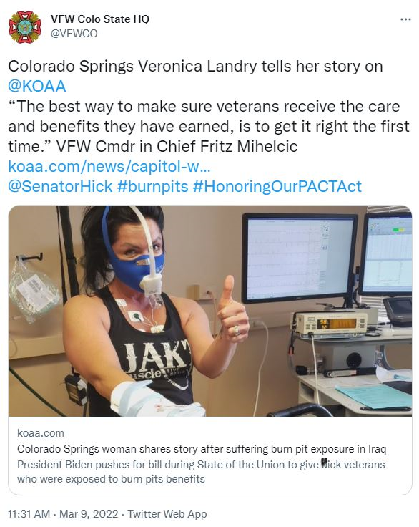
Toxic Exposure Legislation
Leave No Veteran Behind

Slide 8
Toxic Exposure Legislation
Leave No Veteran Behind
Any other questions
Or
Thoughts on Toxic Exposure?
Join Action Corps! Text “VFW” to 50457 or Visit vfw.org/JoinActionCorps

Slide 9
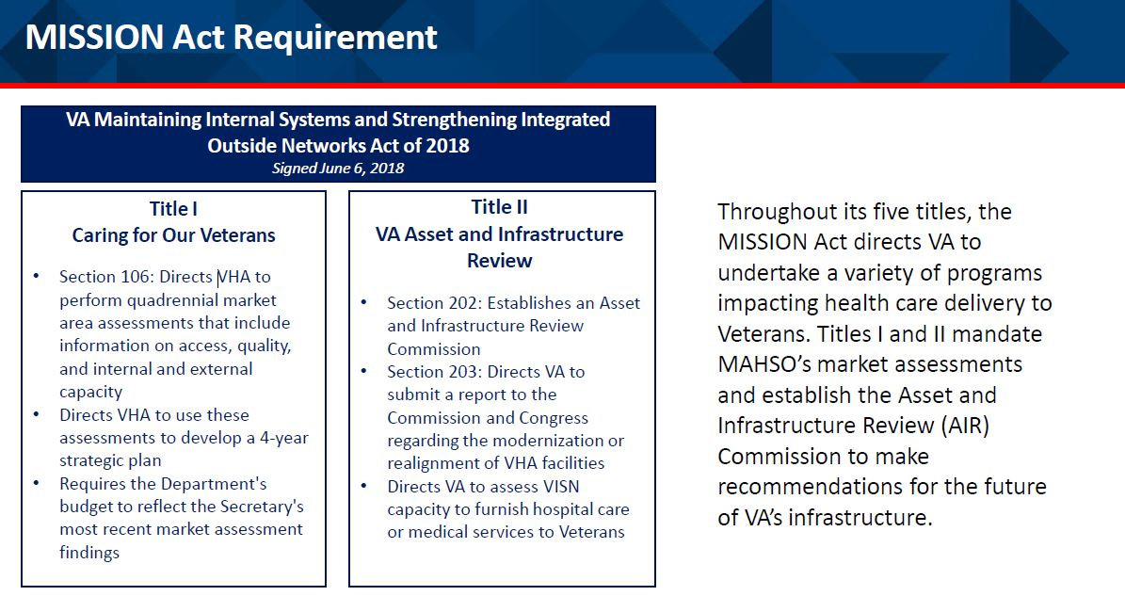
U.S. Dept. of Veteran Affairs
Market Assessment Recommendations
Join Action Corps! Text “VFW” to 50457 or Visit vfw.org/JoinActionCorps

Slide 10
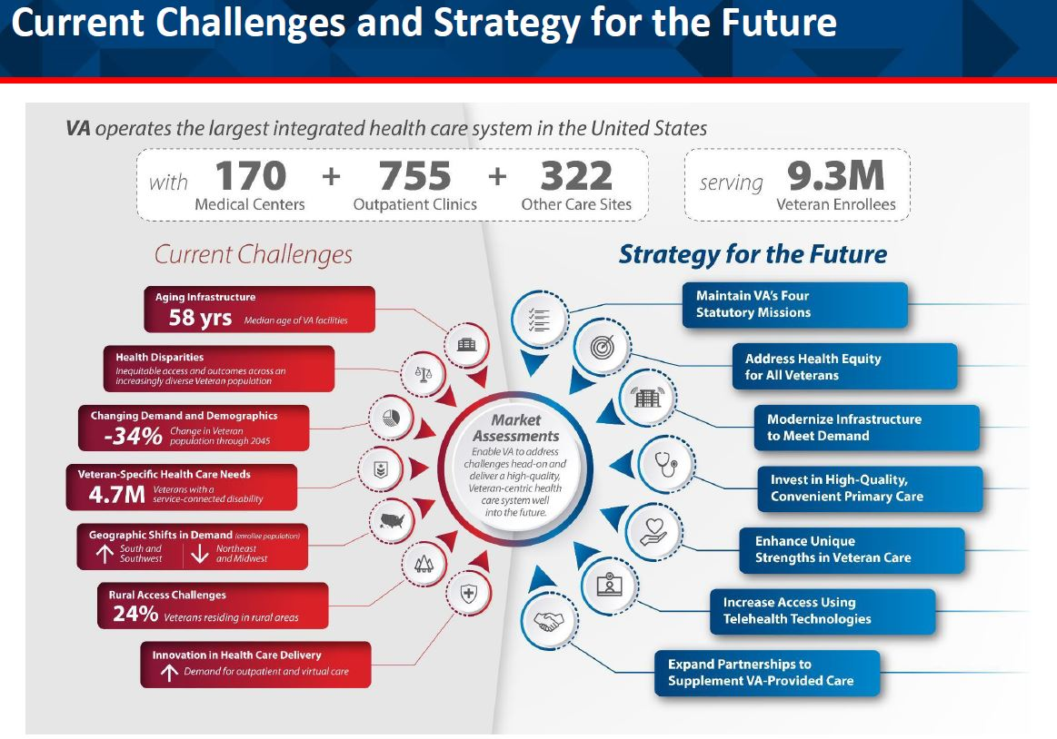
U.S. Dept. of Veteran Affairs
Market Assessment Recommendations

Slide 11
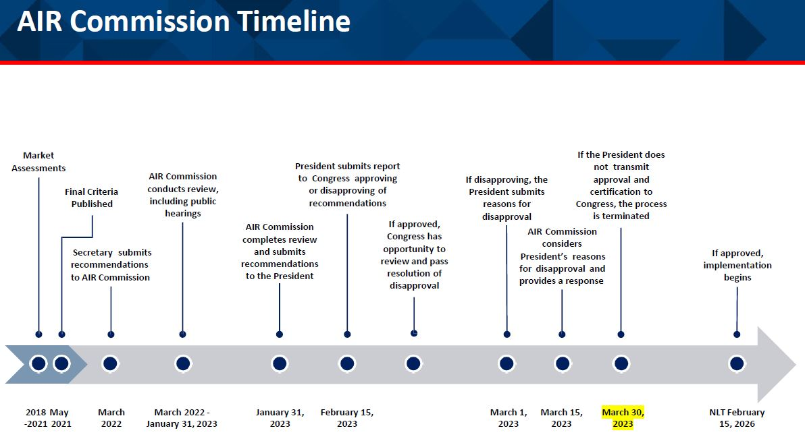
U.S. Dept. of Veteran Affairs
Market Assessment Recommendations

Slide 12
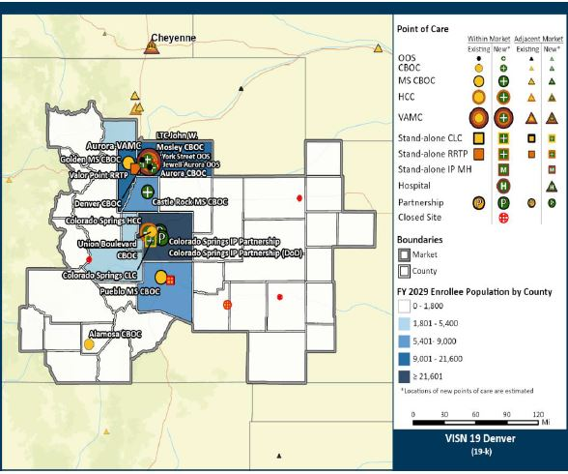
U.S. Dept. of Veteran Affairs
Market Assessment Recommendations
Front Range
Vet Health Admin Users
Market Assessment: ~65,500
National Center for Veterans Analysis and Statistics :~85,000
Join Action Corps! Text “VFW” to 50457 or Visit vfw.org/JoinActionCorps

Slide 13
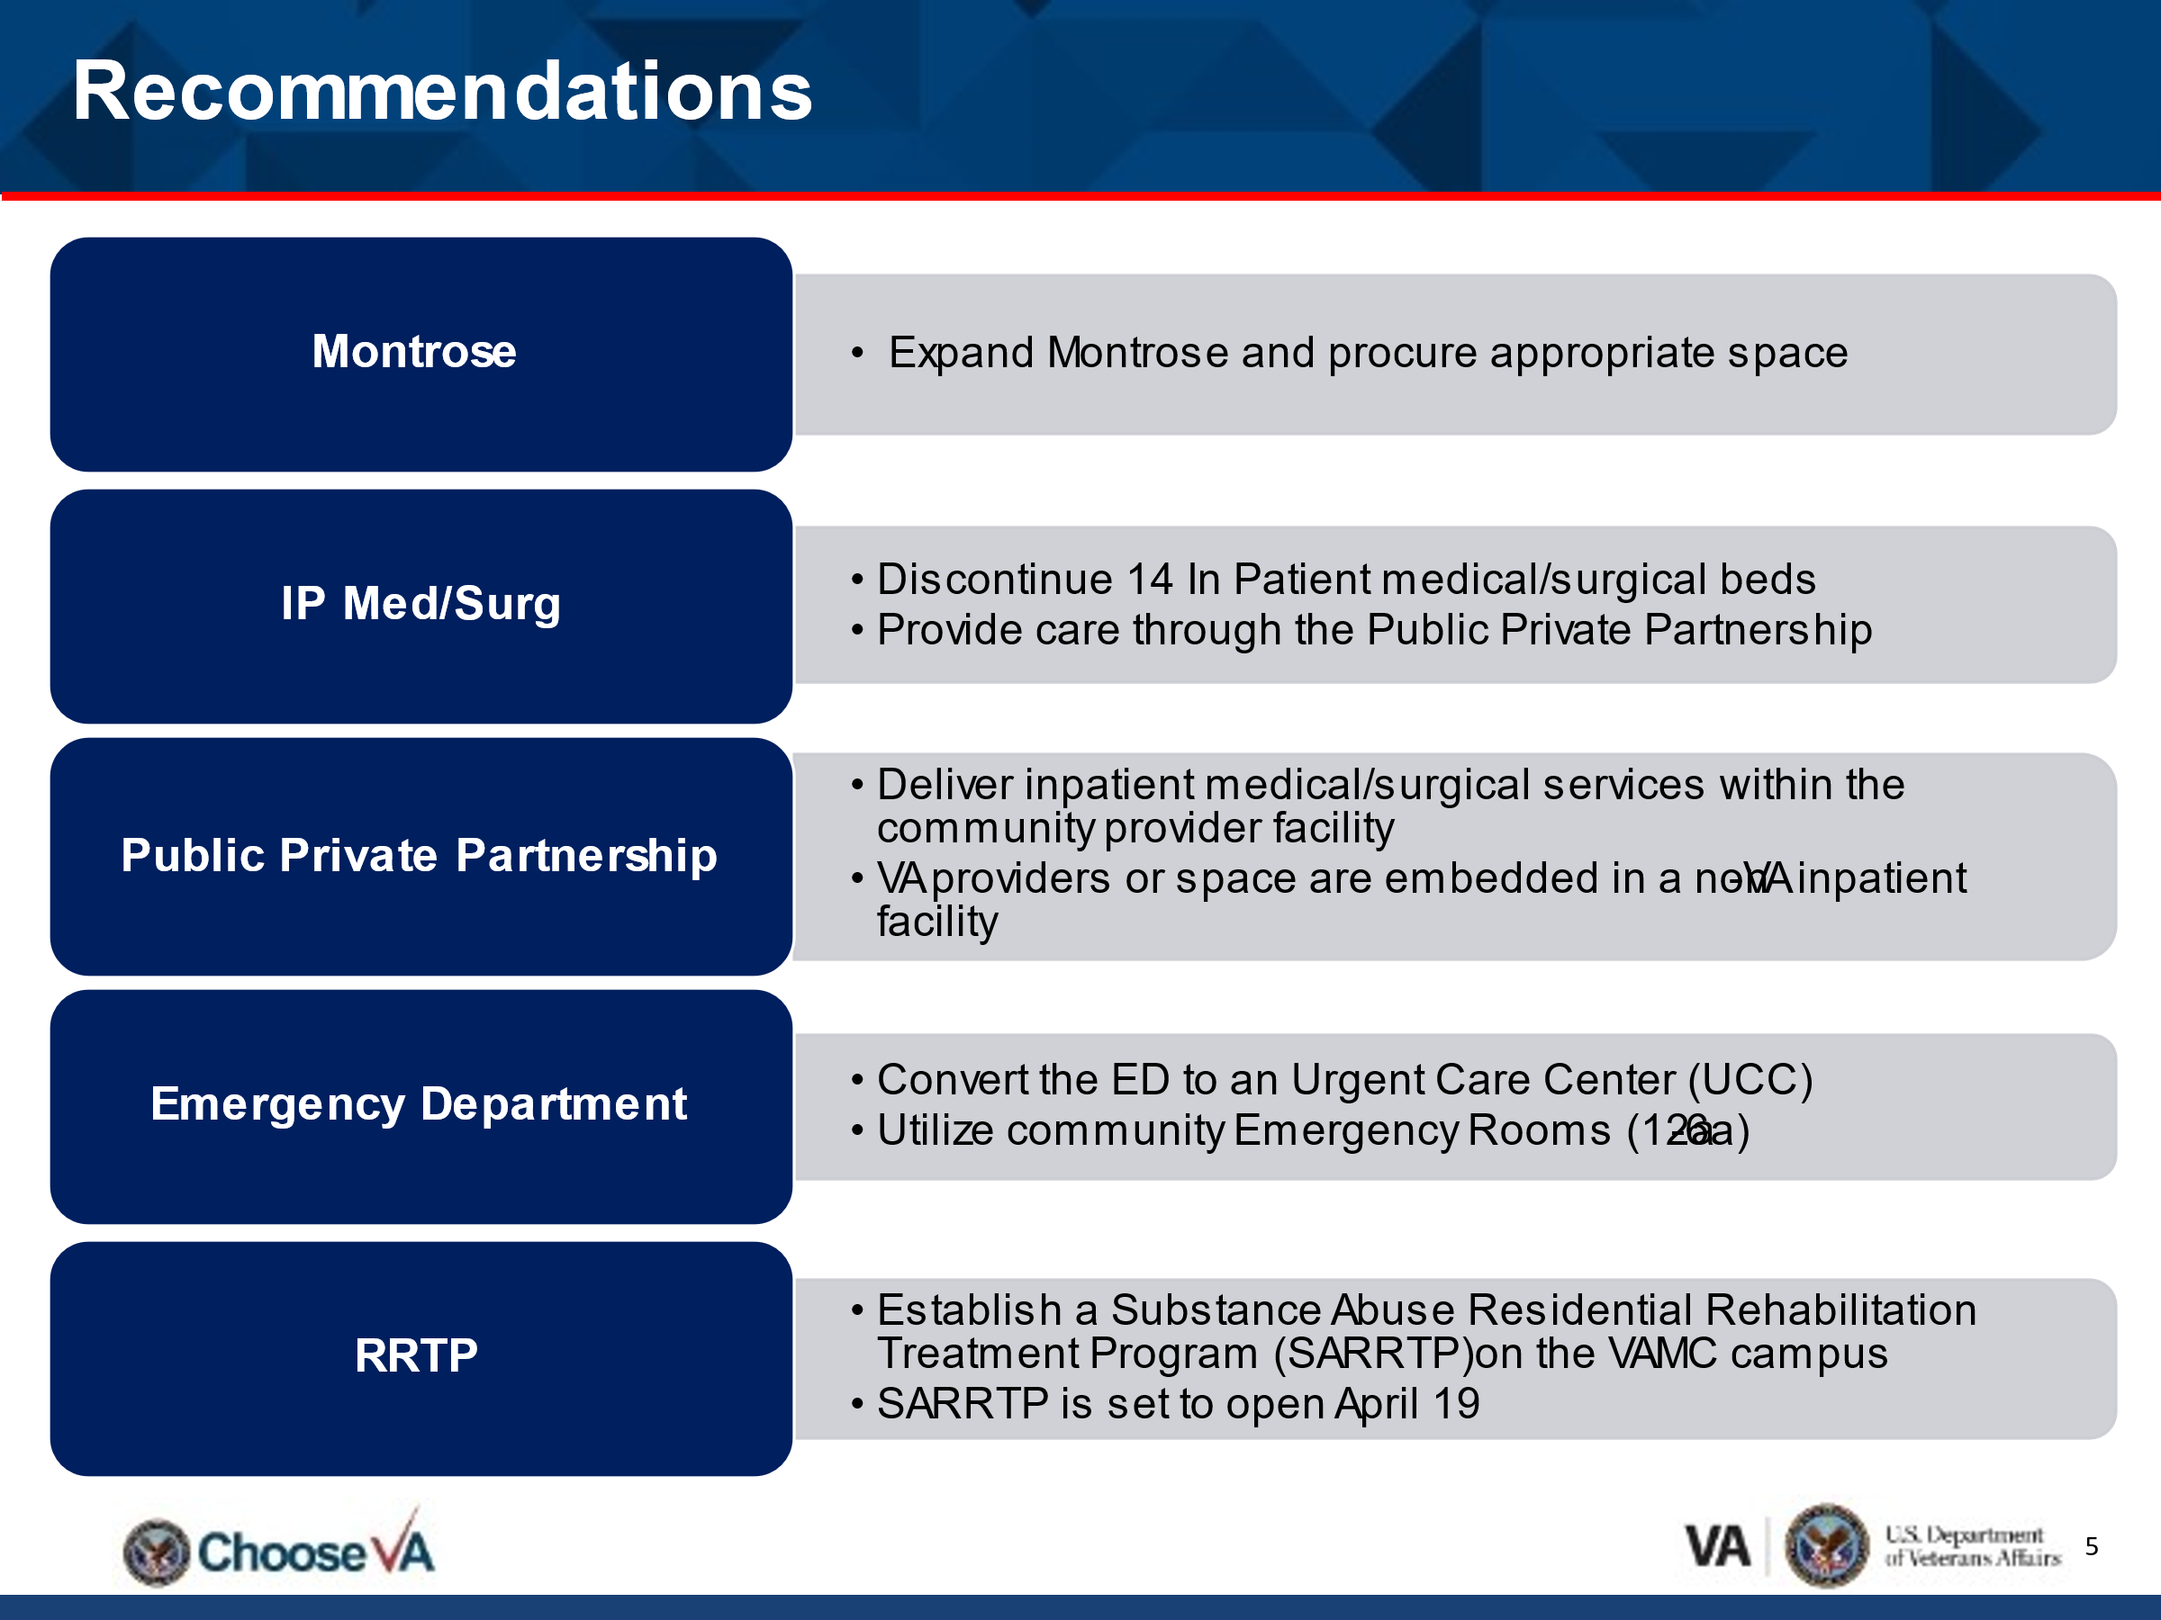
U.S. Dept. of Veteran Affairs
Market Assessment Recommendations
Western Slope
Vet Health Admin Users
National Center for Veterans Analysis and Statistics :~23,000
The VA Veterans Integrated Service Networks (VISN) will not release the user data from the Western Slope to us until Monday
Join Action Corps! Text “VFW” to 50457 or Visit vfw.org/JoinActionCorps

Slide 14
U.S. Dept. of Veteran Affairs
Market Assessment Recommendations
Colorado Springs Market:
Expand the VA Clinic (El Paso County) to increase capacity to provide primary care, outpatient mental health, outpatient specialty care, and women's health services, and add outpatient surgical services, which may result in the classification of the facility as a health care center (HCC).
Join Action Corps! Text “VFW” to 50457 or Visit vfw.org/JoinActionCorps

Slide 15
U.S. Dept. of Veteran Affairs
Market Assessment Recommendations
Any other questions
Or
Thoughts on the Market Assessment Recommendations?
Join Action Corps! Text “VFW” to 50457 or Visit vfw.org/JoinActionCorps

Slide 16

U.S. Dept. of Veteran Affairs
Proposed Rating Changes
The Department of Veterans Affairs is proposing changes to the VA Schedule for Rating Disabilities specifically pertaining to the
Respiratory,
Auditory and,
Mental disorders body systems
The proposed updates to the rating schedule for these conditions will enable VA to incorporate modern medical data and terminology to provide Veterans with more accurate and consistent decisions
Join Action Corps! Text “VFW” to 50457 or Visit vfw.org/JoinActionCorps

Slide 17
U.S. Dept. of Veteran Affairs
Proposed Rating Changes
Proposed updates include:
Modernizing the evaluative rating criteria for sleep apnea, using developments in medical knowledge to evaluate it based on its responsiveness to treatment, bringing the rating criteria for sleep apnea more closely in line with the stated purpose of the rating schedule
Evaluating tinnitus (ringing in the ears) as a symptom of the underlying disease which causes it, rather than as a stand-alone disability
Evaluating mental health conditions based on a more robust and holistic approach that assesses how impactful the disability is to cognition, interpersonal relationships, task completion, life activities and self-care. Additionally, the proposed evaluation criteria include a 10% minimum evaluation for having one or more service-connected mental health conditions and will no longer require “total occupational and social impairment” to attain a 100% evaluation
Join Action Corps! Text “VFW” to 50457 or Visit vfw.org/JoinActionCorps

Slide 18
U.S. Dept. of Veteran Affairs
Proposed Rating Changes
No change to a Veteran’s current rating would occur due to these proposed changes
If the proposed changes are finalized, Veterans who currently receive compensation for a service-connected condition can apply for increased compensation, but no reductions shall be made unless an improvement in the Veteran’s disability is shown to have occurred.
Please provide comments to the proposed changes on the Federal Registry
Find the links to the Federal Registry page at
https://linktr.ee/vfwco
Join Action Corps! Text “VFW” to 50457 or Visit vfw.org/JoinActionCorps

Slide 19
Listening Session here at 4pm
Bring your questions, thoughts, and ideas about what I briefed today
Steve Kjonaas
VFW Colorado Legislative Director
Steve@VFWCO.Org

