Slide 1
Colorado VFW Warriors
PRESENTATION 16 OCT 2021

Slide 2
AGENDA
MISSION
VISION
HISTORY
oRGANIZATION
COMMUNITY RESPECT
DISTRICT
DEPARTMENT

Slide 3
MISSION
The mission of the Veterans of Foreign Wars, Warriors Motorcycle Organization is to promote Colorado State Veterans of Foreign Wars missions, develop membership growth for the Veterans of Foreign Wars, increase community awareness, and to promote interest in various forms of motorcycle activities that shall foster camaraderie among membership; and to encourage a better understanding of motorcycle riding as a constructive activity among members of the Veterans of Foreign Wars, the Auxiliary, and the public; promoting motorcycle safety programs; and providing a social atmosphere for Veterans of Foreign Wars and the Auxiliary who share the same interest. Money raised during motorcycle fund raising events shall go to support Veterans organizations, facilities, causes, and charities that directly benefit Veterans and their families.

Slide 4
VISION
to promote Colorado State VFW missions
develop growth for the VFW
increase community awareness of VFW functions
to promote interest in various forms of motorcycle activities
foster camaraderie amongst membership
to encourage a better understanding of motorcycle riding as a constructive sport among members of the VFW, and the Public COMMUNITY
providing a social atmosphere for Veterans of Foreign Wars and the Auxiliary who share the same interest

Slide 5
WARRIORS HISTORY
VFW National Commander-in-Chief, Edward S. Banas approved Colorado VFW Post 101 on 15 Oct 2004, the request to use the VFW Name, Maltese Cross and or logo on a patch to read "VFW Warriors";
VFW Warriors MC, General Membership approved in April 2006, through a majority vote of thirty seven members to wear a one piece patch as the "VFW Warriors" Motorcycle Organization;
Colorado State VFW, Department Commander, Earl Haven, Approved and signed the first State CVMO Policy on 18 March 2007;
VFW National approved the General Committee Resolution 108, dtd 11 Aug 2010 to authorize the “VFW Riders”.
On November 18, 2010, The VFW National Commander, Richard L. Eubank approved the official name for Colorado VFW Warriors Motorcycle Organization.

Slide 6
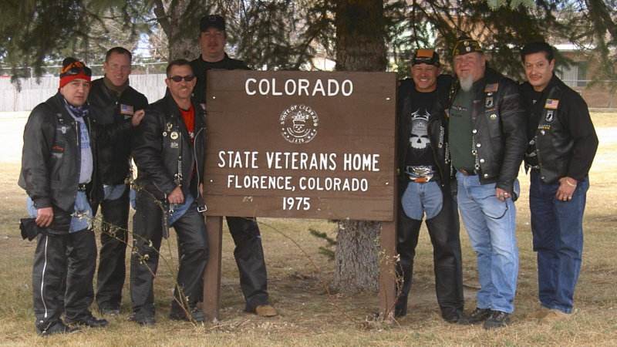
VFW Warriors MC
2005

Slide 7
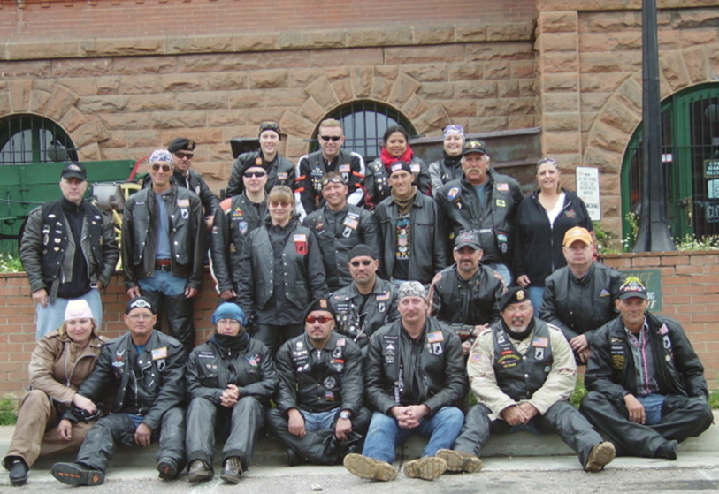
SALUTE TO VETERANS
Cripple CREEK 2006

Slide 8
VFW Warrior District Presidents
> District 1 - Phil Roemmich - altamann5810@gmail.com
> District 2 - using Geraldine Rimpley - raftergllc@gmail.com
> District 3 - Dave Gelatt - david.gelatt@comcast.net
> District 4 - Ken Davidson - otismates@gmail.com
> District 5 - Jeff Buchwalter - buchwalterfamily@msn.com
> District 9 - Gerald Martinez (post 4265 QM)- Don't have and email address. Maybe you can get it from Department HQ
> District 10 - David Bleau - DavidBleau@comcast.net
> District 12 - Jerry Sallee - tazpreacher@gmail.com

Slide 9
leadership
VFW District
Commander
State VFW
Commander
State Warrior’s
President
Warriors District President
Vice President
Sgt. @ Arms
Treasurer
Trustee
Quartermaster
1:
2:
3.
A Post Rep can be part of the Road CPT pool if application made and approved by the Sr. Road Cpt. The post rep is not necessarily have to be a Road Captain.
Updated: 30 SEP 2021

Slide 10
District _ BOD SUPPORT Layout
President
A post rep can be part of the Road CPT. pool if application made and approved by the Sr. Road Cpt. The post rep is not necessarily a road captain.
Vice President
Sgt. @ Arms
Treasurer
Trustee/PAO
Senior Road Cpt. & Road Cpt.
Secretary
Chaplain
PAO
Road Lt. Pool
Post Representative
Post Representative
Post Representative
Post Representative
Post Representative
Post Representative
Post Representative
Members
Members
Members
Members
Members
Members
Members

Slide 11
Community
Every city and local town where we ride or are located
Post, District, State, National
We support Veterans, Soldiers, Families
Colorado Springs Homeless Initiative
Funeral Escort Missions
Toys for Tots (since 2006)
Run for the Wall
Vietnam Traveling Wall
National and State Veterans Homes
VFW National Childrens Home
COC- Motorcycle Club organization of Clubs
BUFA- Bikers United For America
Vets 4 Vets (CVMA, ALR, SFMC, VMC, WARRIORS)
HOGS-Harley Owners Groups
VFW RIDERS (50 STATES AUTHORIZED BY NATIONAL VFW COMMANDER)

Slide 12
RESPECT
A serious MC club commands respect for one reason. Those who are correctly informed recognize the deep level of personal commitment and self discipline that a man has to demonstrate and sustain in order to wear a patch.
This is respect born out of recognition of dedication and accomplishment. The MC Club strives for respect for this reason.
  This is especially true as it pertains to those persons outside of the motorcycle community WHICH represents a larger market for any fund raising activities that the group might undertake.
    cultivating a relationship with these people is important, and to be perceived by them as "Biker Scum" would not be advantageous to the group.
  WE will therefore conduct OURselves as upstanding citizens in every way... "Good neighbors" so to speak.
The goal is to be admired and respected by the general public rather than feared.
The serious club, and all of its members and guests, will always conduct themselves publicly in a highly professional manner.

Slide 13
VFW MEMBERSHIP IS ALWAYS FIRST
Respect and commitment to the vfw post
As veterans we search and bond with our own
ShARING OURSELVES, OUR STORIES, OUR EXPERIENCES
NO ONE IS ALONE, WE EACH HAVE OUR DEMONS TO DEAL WITH
WORKING TOGETHER WE MAKE A DIFFERENCE IN OUR POST, IN EACH OTHERS LIVES, IN THE COMMUNITY AND IN THE NATION.
CURRENT STATEWIDE vfw Warriors Membership : 250 members
AVERAGE MILEAGE IS APPROXIMATELY 5000 PER MONTH

Slide 14
QUESTIONS?

